Slide 1

MyLegion My Groups:
Reports
Create, print and save membership reports, letters and labels.
2025

Slide 2
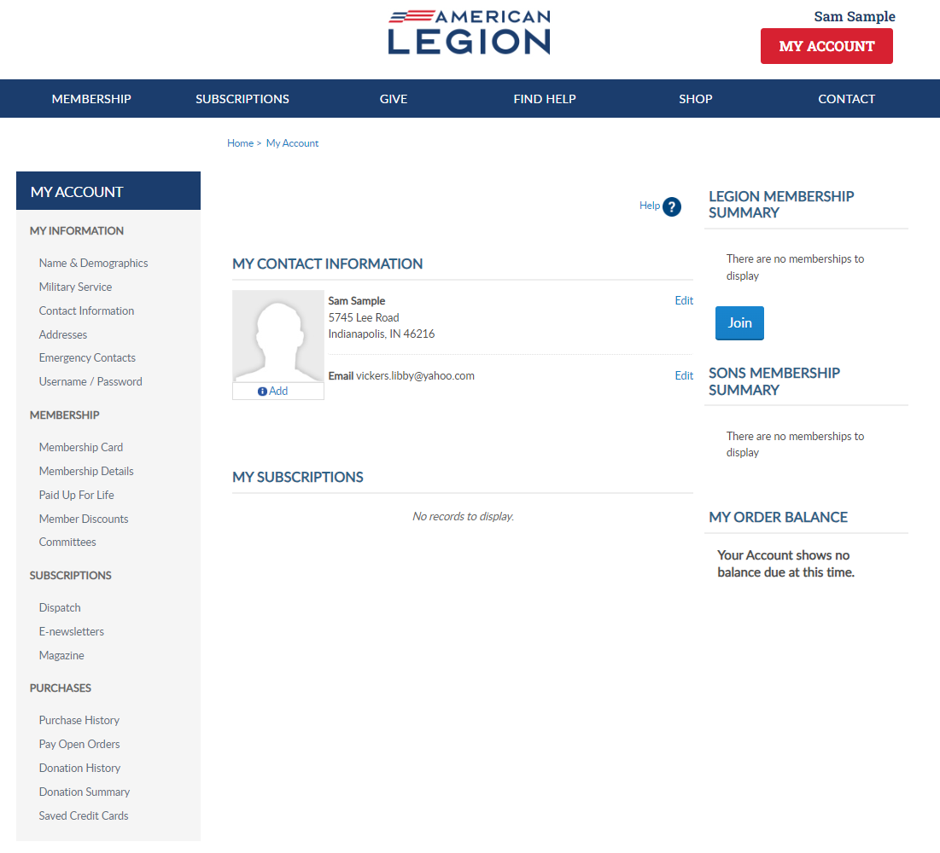
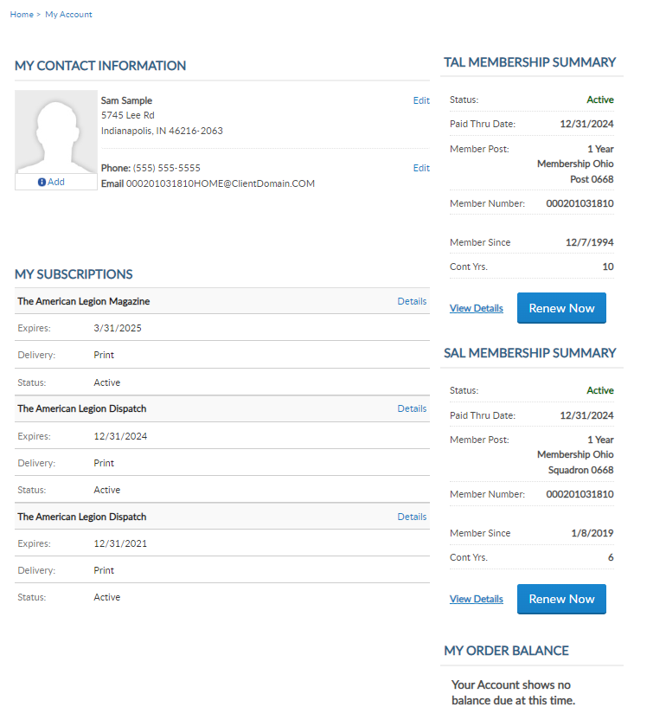

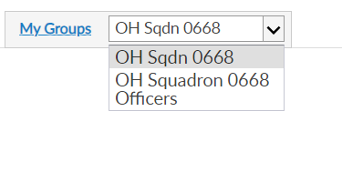
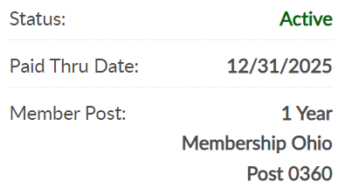

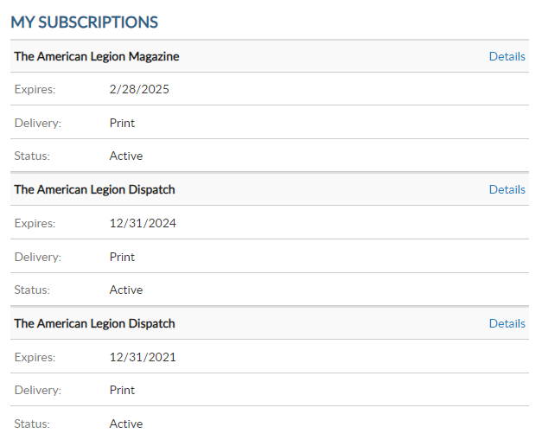
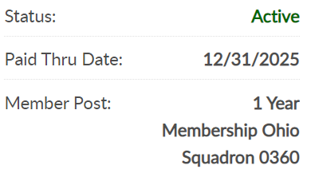

000123456789
PrimaryEmailAddress.com
000123456789
Notes:
My Groups is available when the member is recorded as an adjutant or commander of a post, squadron, district, county, department and detachment. The group menu is related to your position.
Adjutants and commanders, through their individual accounts, will have a My Groups area to assist with post and squadron administrative tasks. A post officer will have access to both Legion and Sons of the American Legion membership. SAL officers will have a menu with 2 groups. <1>

Slide 3
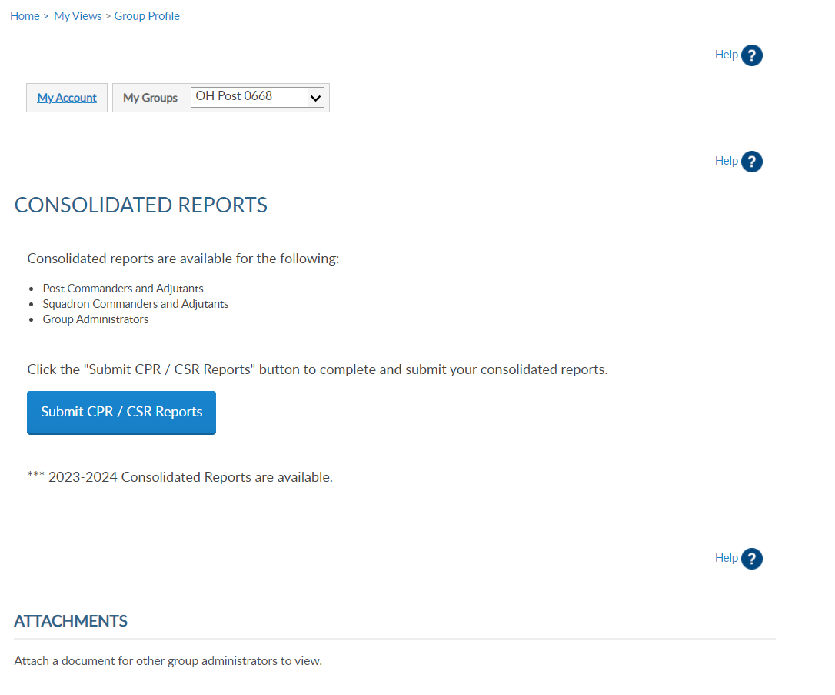
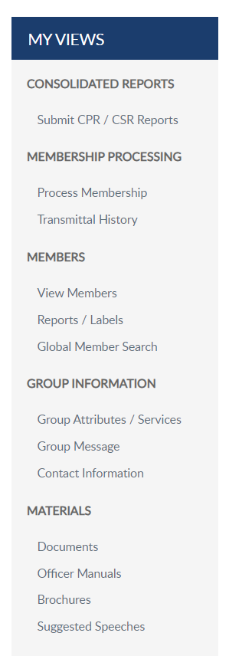

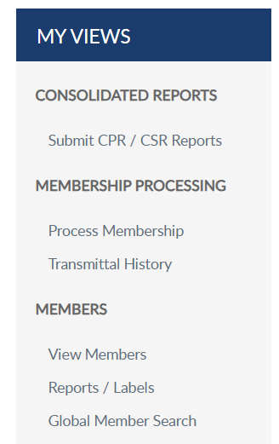

REPORTS
Notes:
When you are in group profile, take note to the group selected. This is the group to which administrative tools are featured.
<1> MyLegion reports are found in the left menu. Consolidated reports display as the group profile main landing page. To submit or view a consolidated report, select “Submit CPR/CSR Reports in the left menu or from the dashboard. <2>

Slide 4
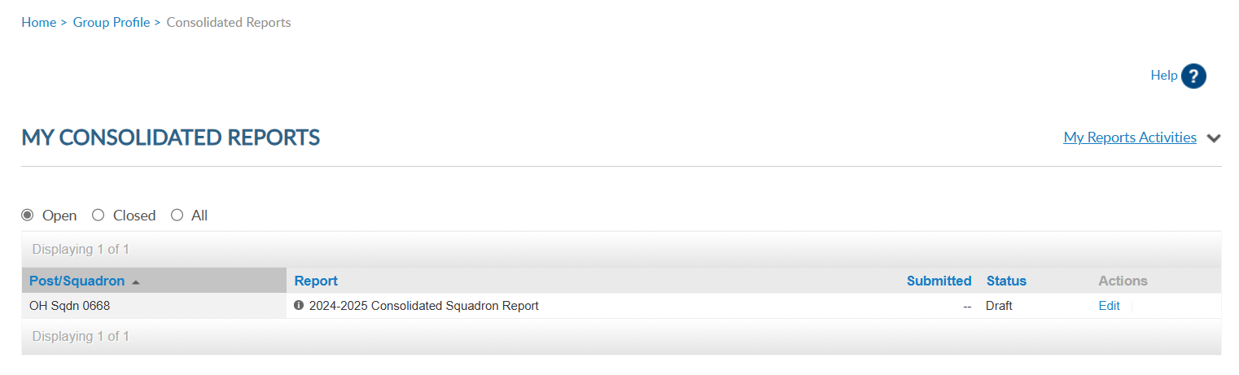
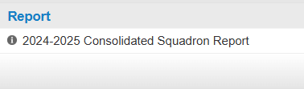
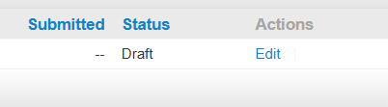
Do not submit a paper form if submitting online.
Detachments have access to online reports.
Notes:
There are 3 view areas in consolidated reports. Open reports are available to enter data while in draft status.
There is only one open report for the reporting year. When available, you can edit the report until the report is submitted or the final submission date.
To enter information in the report, click Edit. <1> If you submit online, you do not need to mail a paper form. The department has access to submitted report data.

Slide 5
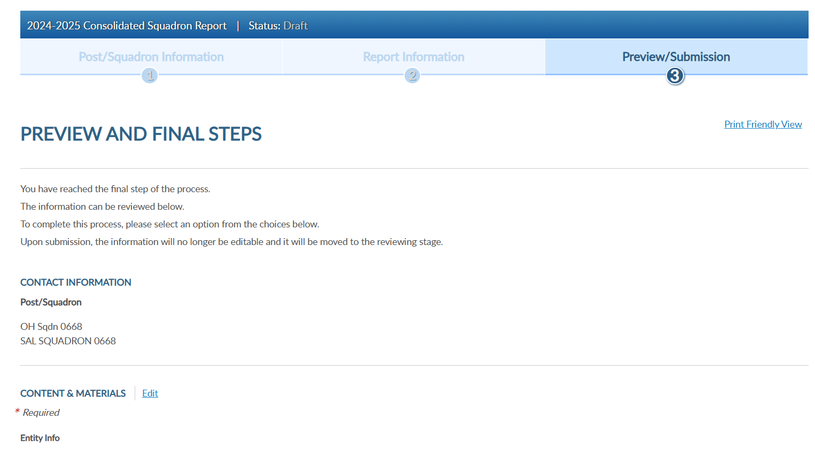
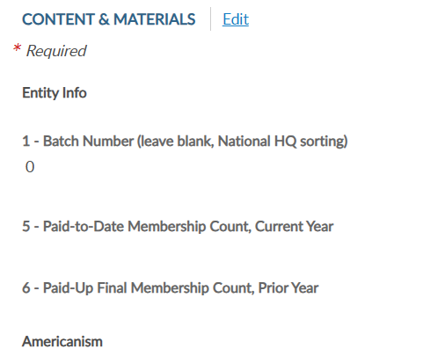
Notes:
Click edit to open the fillable form.

Slide 6
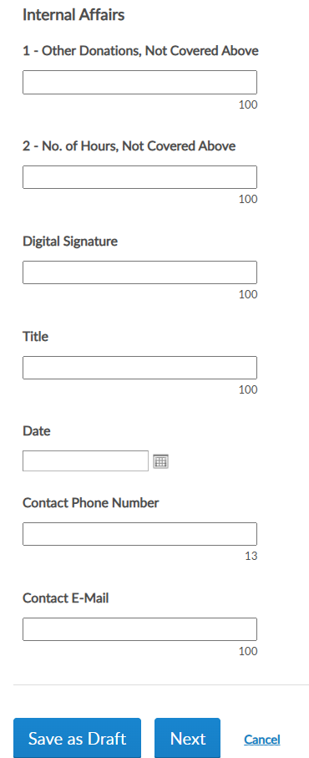
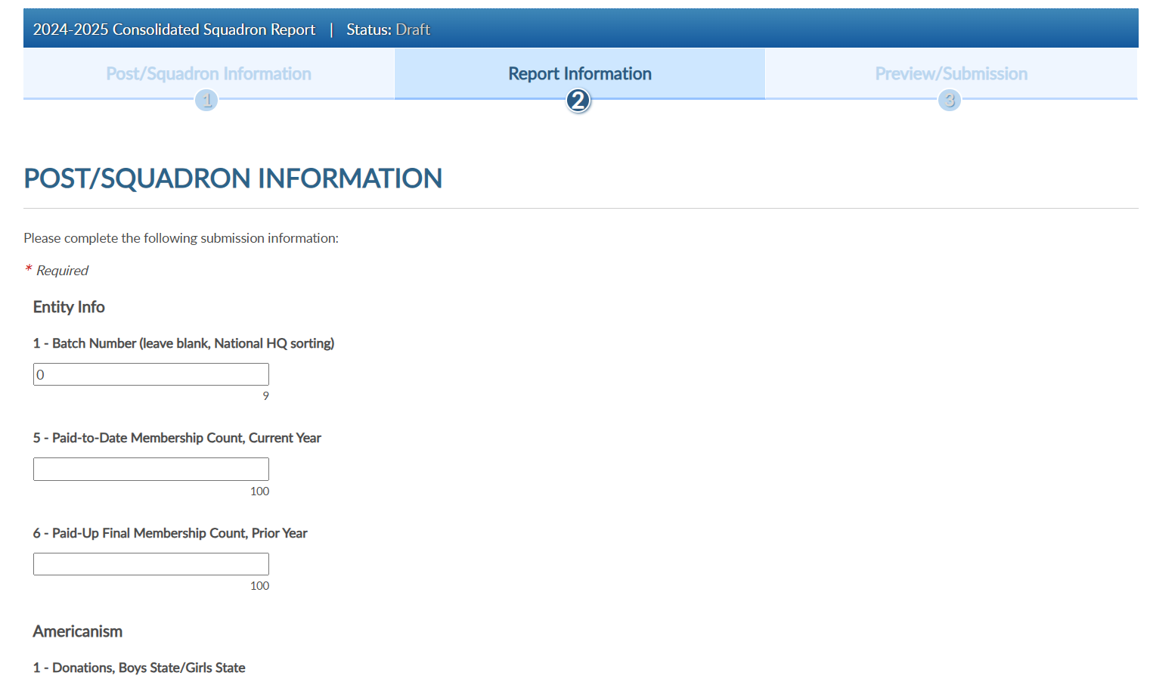
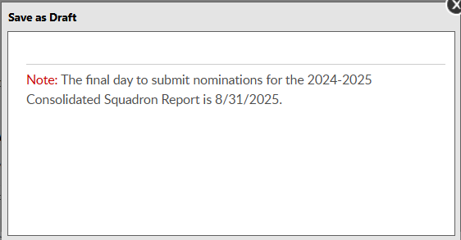
Notes:
When your entries are complete save the draft or finalize the report. These buttons are located at the bottom of the form.
To save and return to the form later, choose Save as Draft. <1> the draft must be finalized by the assigned deadline.

Slide 7
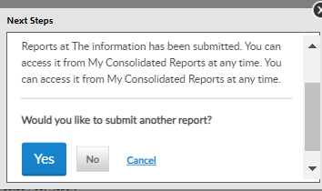
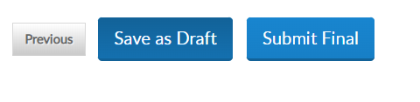
Report has been submitted. You can access it from My Consolidated Reports at any time.
Would you like to submit another report?
Notes:
To finalize the report, click Next <1> to view and select the Submit Final button. You will receive a notification the report is submitted. <2>
Note, once the report is finalized it is saved as a submitted report. You will not be able to add data. If you plan to make additional updates, click Save as Draft and finalize by the due date.

Slide 8
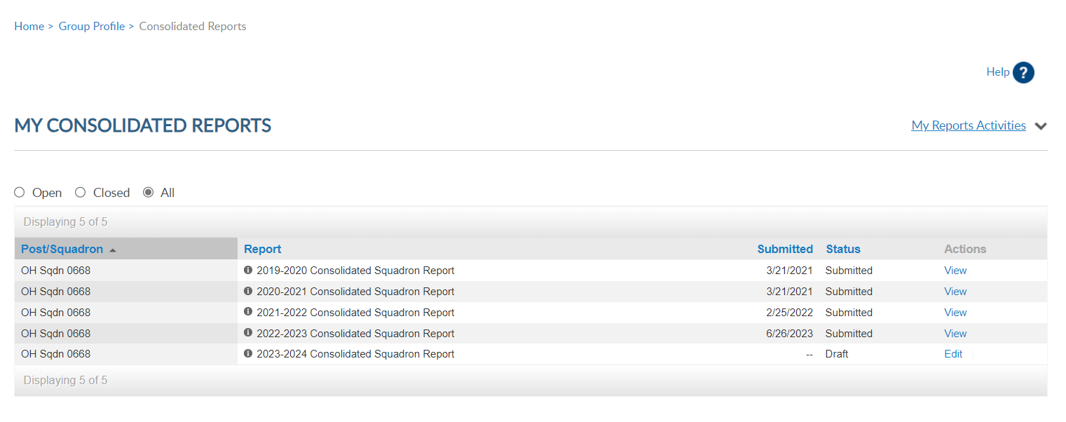
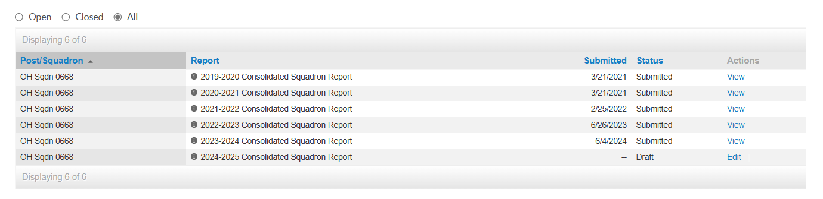
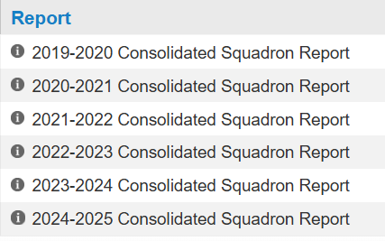
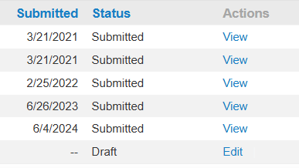
Notes:
Submitted reports will remain in the Open area with a submitted status until the report is closed for the year. To view, or print a report click View.
Reports from the 2020-2021 reporting years are available.

Slide 9
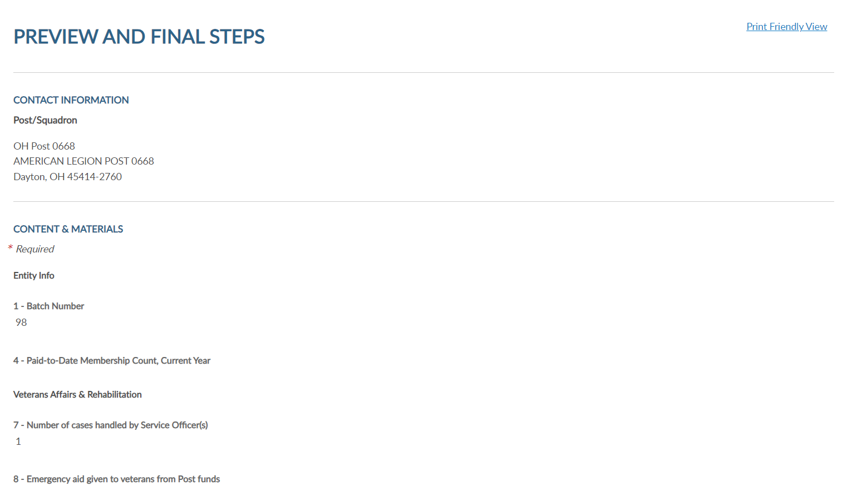

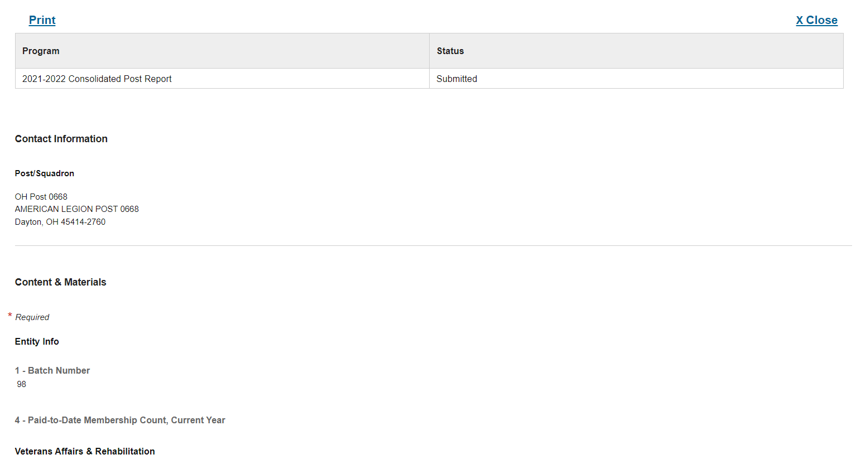
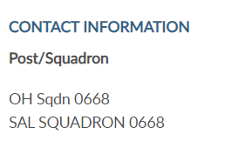
2022-23 Consolidated Squadron Report Submitted
OH Squadron 0668
Dayton, OH
Notes:
Select Print Friendly View to advance to Print. This allows you to print the report as a PDF document. Close the form to return to groups menu.

Slide 10
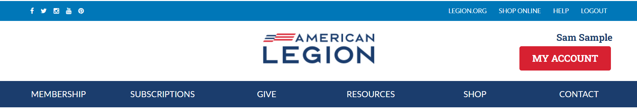
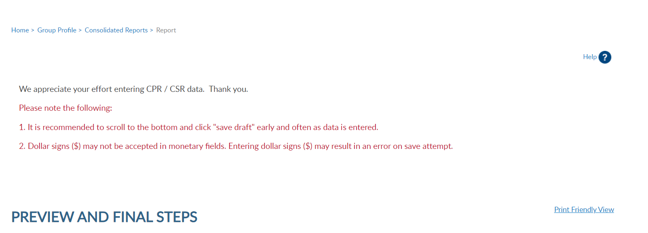
Notes:
Click on Group Profile to return to group administrative window.

Slide 11

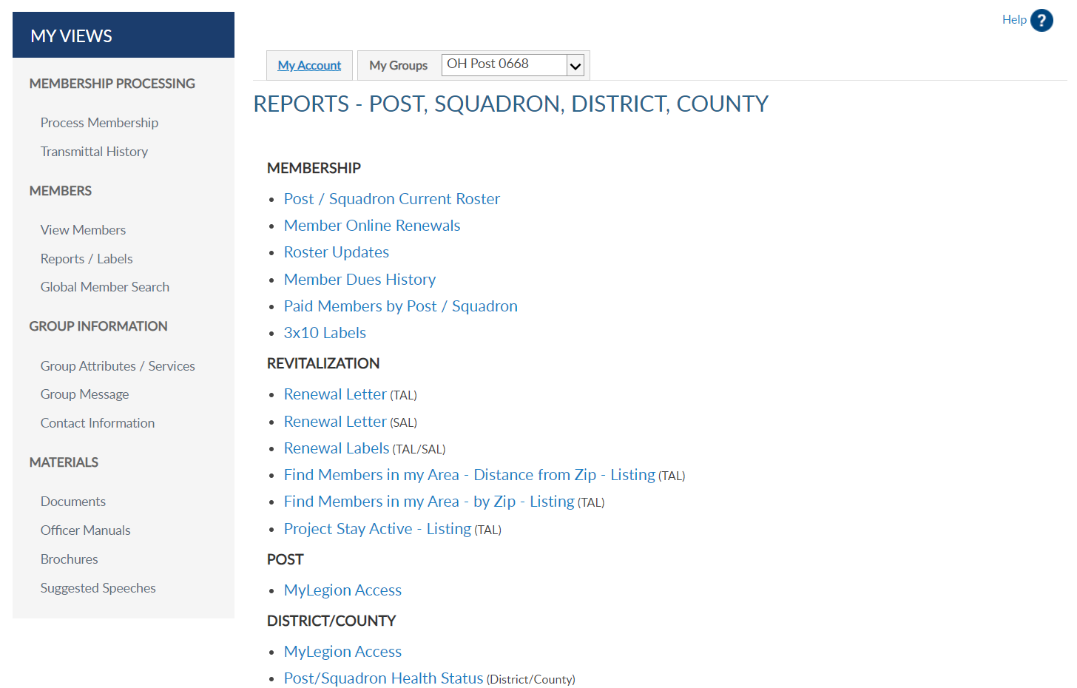
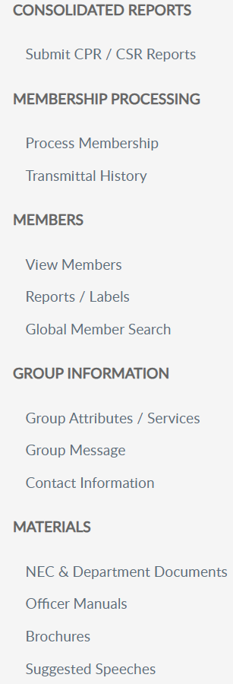
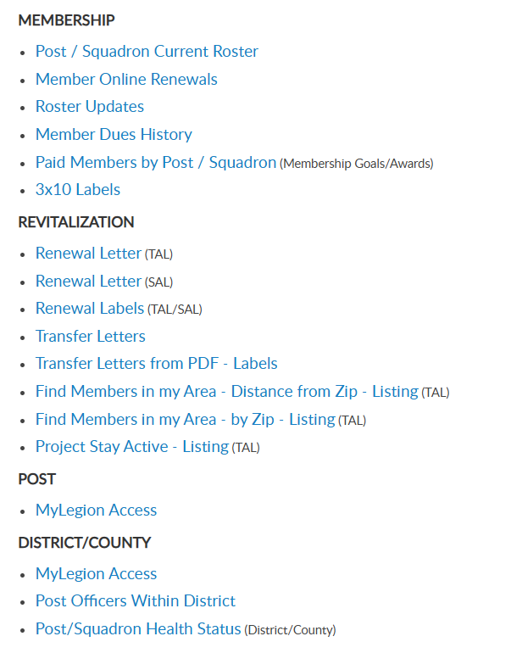
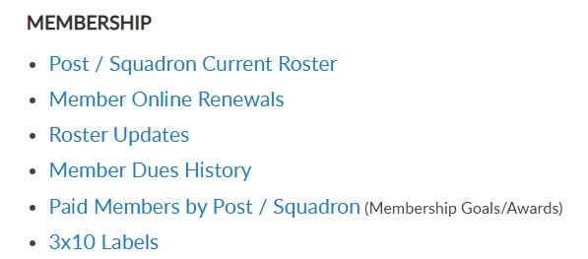
Notes:
Membership listings, roster updates, members renewed online, HQ member listings, mailing labels and a renewal letter are available through Reports/Labels.
Reports include post and squadron membership assigned to your group. To generate reports, you will first select the report and then the group and criteria. Let’s begin with a current roster report. Click on the report name to proceed.

Slide 12
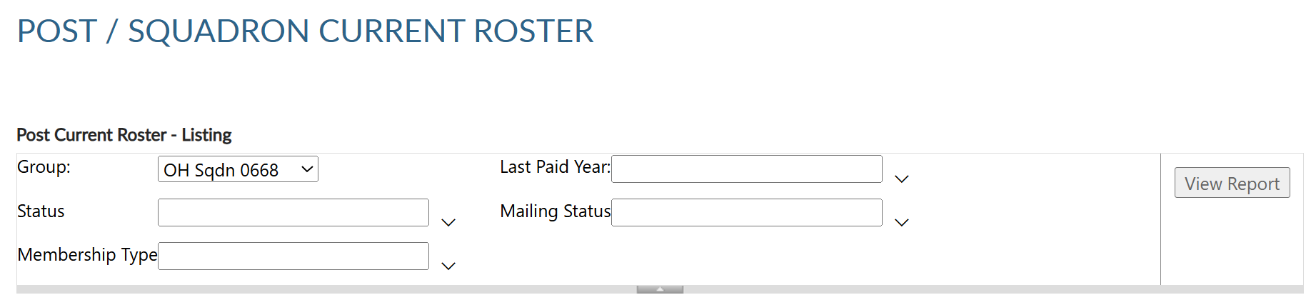
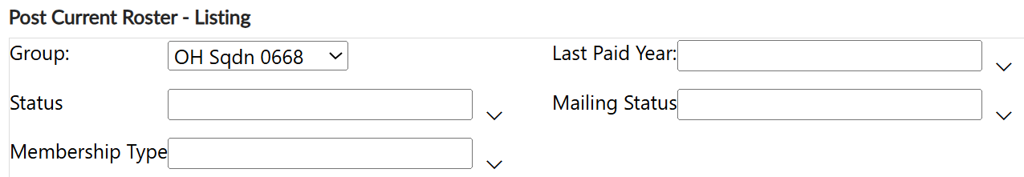
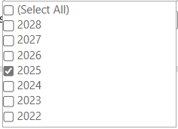
Displays members who are currently assigned to your squadron. Includes expired and deceased.
CURRENT ROSTER
Notes:
All reports are created using data filters. Filtering menus allow flexibility to the data included in the roster. The first field selected is Group. Using the pulldown menu select your group.. Next select last paid year. <1> Legion members who purchase a multi-year renewal or PUFL display a last paid year purchased.

Slide 13
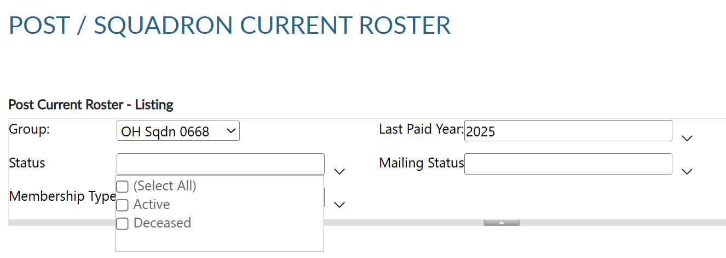
Displays members who are currently assigned to your squadron. Includes expired and deceased..
CURRENT ROSTER
Notes:
Status includes active and deceased. Deceased members will remain on the roster and can be filtered out by selecting active only.

Slide 14
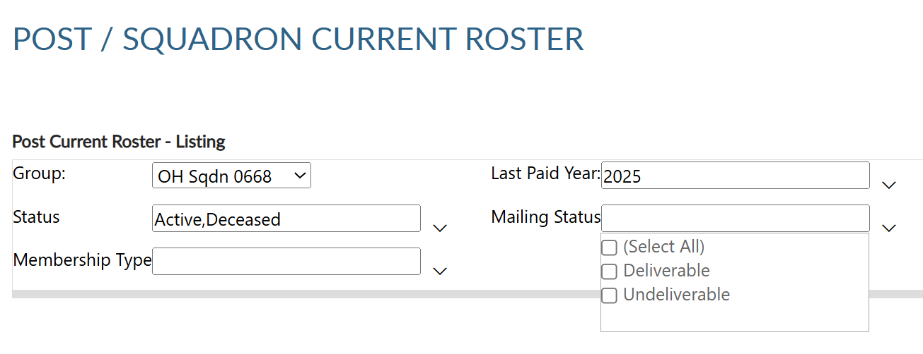
CURRENT ROSTER
Notes:
The next filter is mailing status. Mail status let’s you know if the mailing address on file is good or flagged as undeliverable. Members with undeliverable status do not receive The American Legion Magazine, renewal notices, or any mailings from National Headquarters. Contact those members, if possible, to collect a valid mailing address and update. Updating an address that marked as undeliverable will remove the flag. If a member states the address on file is good, contact National Customer Service to remove the flag.

Slide 15
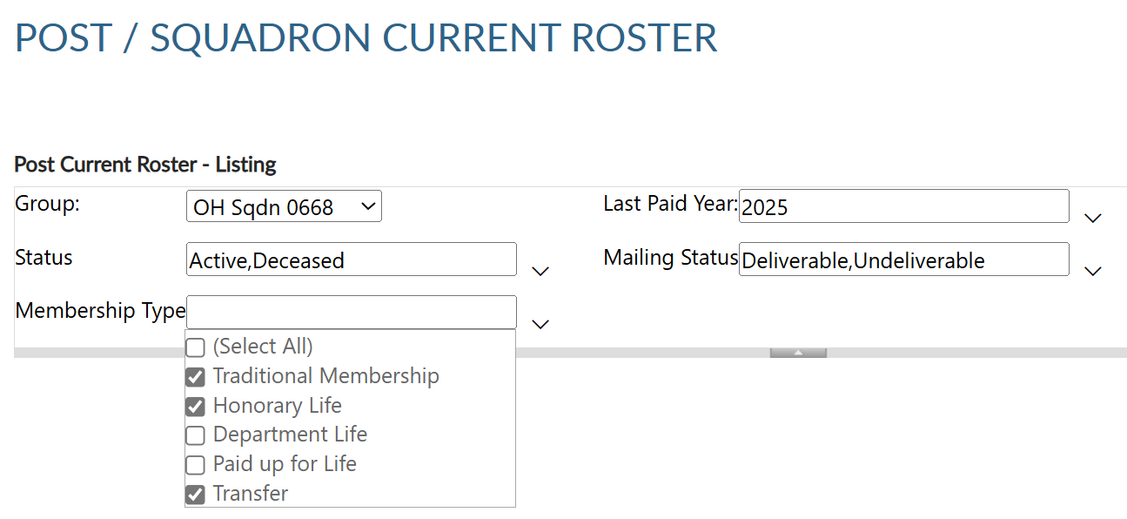
CURRENT ROSTER
Notes:
Membership type includes traditional 1-year renewal, honorary life, department life, paid up for life and if the member is a current transfer. Not all apply to SAL membership.

Slide 16
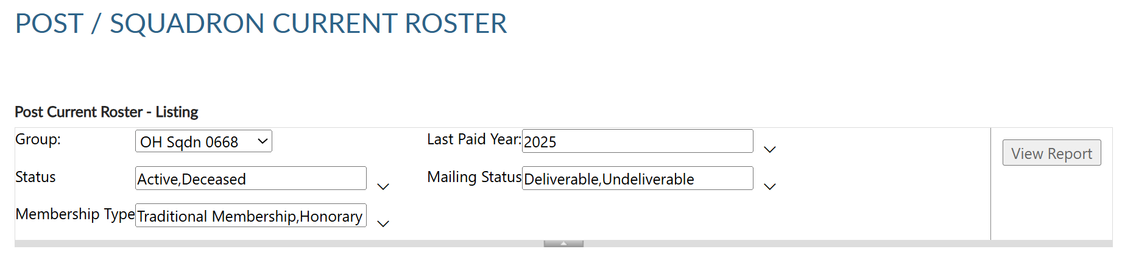

CURRENT ROSTER
Notes:
After all data fields have been set, click View Report.

Slide 17
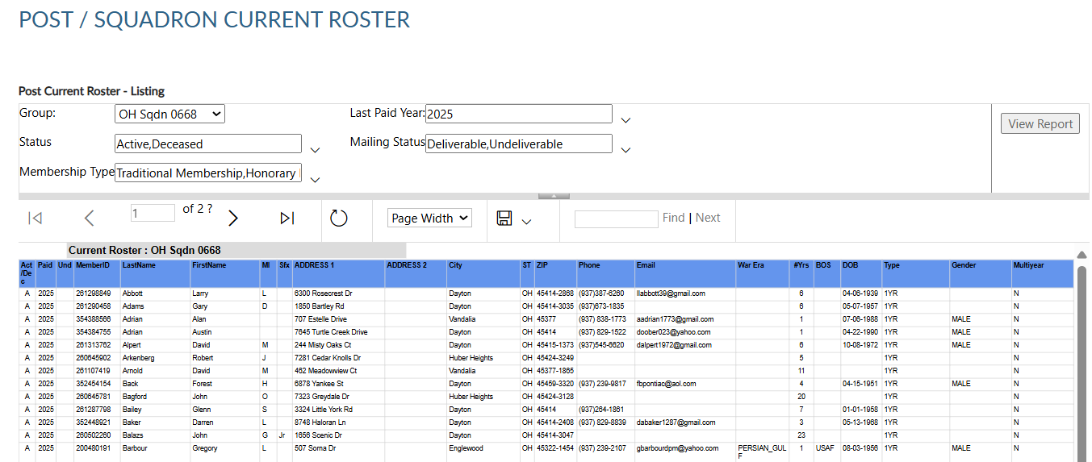
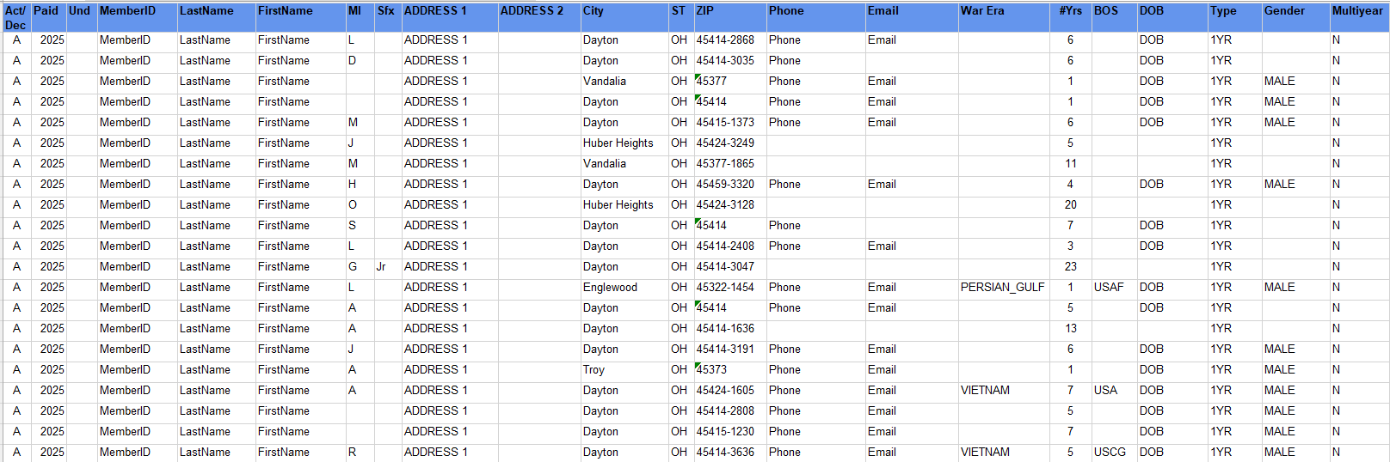
Notes:
The roster includes status, paid year, contact information, conflict, continuous years, branch of service, date of birth and membership type.
This listing only includes current members of your group. Members who have transferred out, are not included in current membership. To view members who have paid to your post or squadron, generate a Paid Members report.

Slide 20
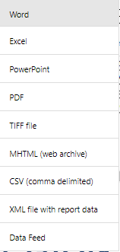
Notes:
Using the export Icon, export to an Excel document.

Slide 21
Notes:
Members that renew online can be identified using the Member Online Renewals Report.
Online renewal is available for Legion and Sons of the American Legion membership.
Click on the blue hyperlink to begin the members online renewal report.

Slide 22
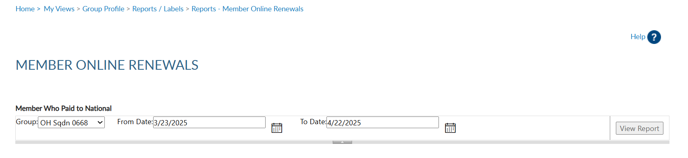
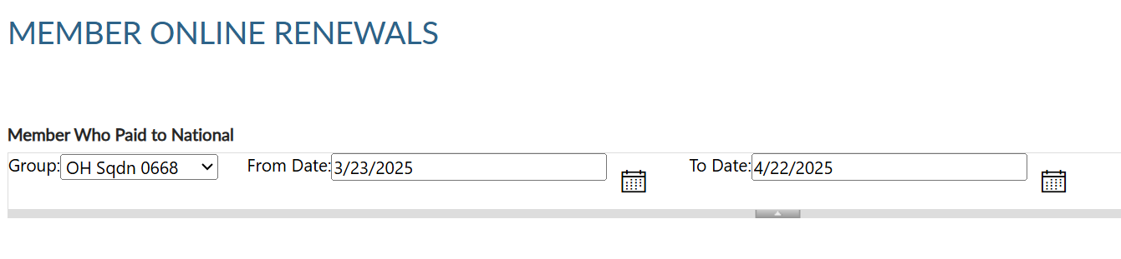
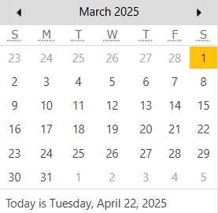
Lists member paid online through national headquarters.
MEMBER ONLINE RENEWAL
Notes:
Group selection is required. Date range selection is updated by clicking on the calendar icon. <1> Use the left and right arrows to navigate by month and year. Click on the date in the calendar to set. <2> Click View Report to generate listing.

Slide 23
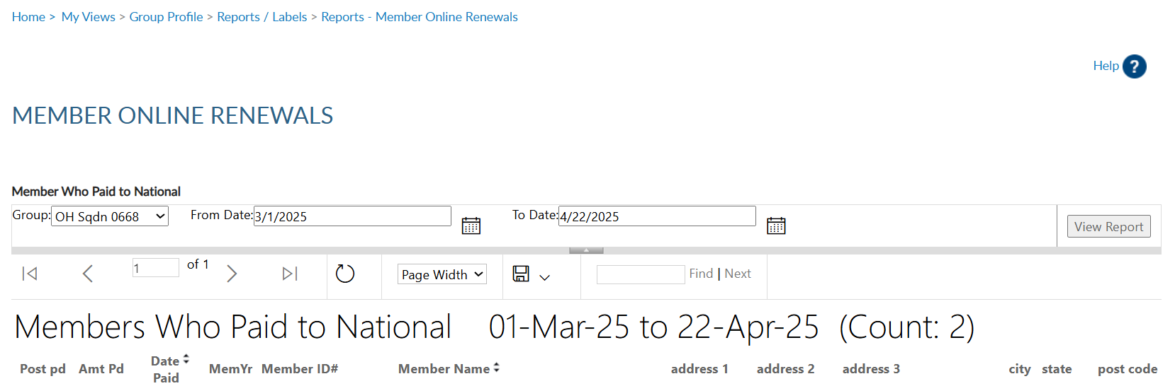
MEMBER ONLINE RENEWAL
Notes:
This report provides the total count with names, member id#, date and renewal year. The amount paid displays the total amount of dues collected by the member, as reported on the annual squadron data report. When a member renews online, National collects post dues, and sends all others to the department to distribute.
If the squadron dues do not cover the minimum of national plus detachment, online renewal will not be available and result in an error message if the member attempts online renewal.
The export icon <1> is used to print and save reports. Reports are not saved within the report writer.

Slide 24
Notes:
The next report is Roster Updates. This report helps identify members who have transferred in and out of your squadron, new joins and other updates made on the member record.
Select Roster Updates blue hyperlink to begin.

Slide 25
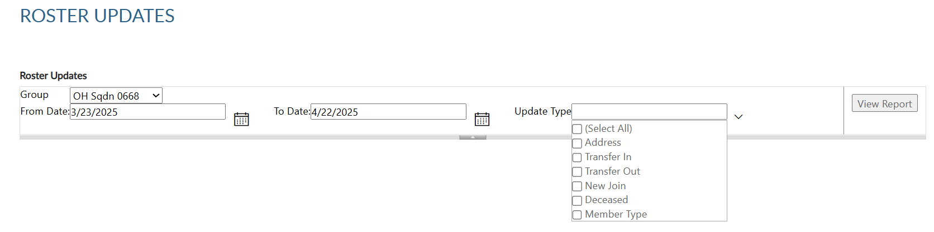
Updates to member information for address, deceased status, transfer information and new members (new join).
ROSTER UPDATES
Notes:
Select your group and date range using the calendar icons. Select update type or all. After all filters are set View Report to generate. <1>

Slide 26
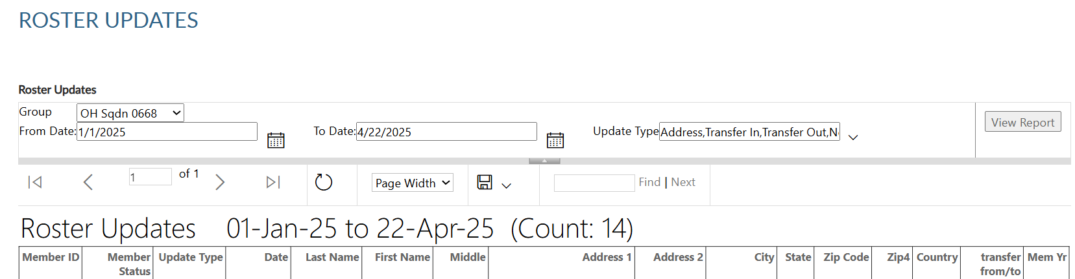
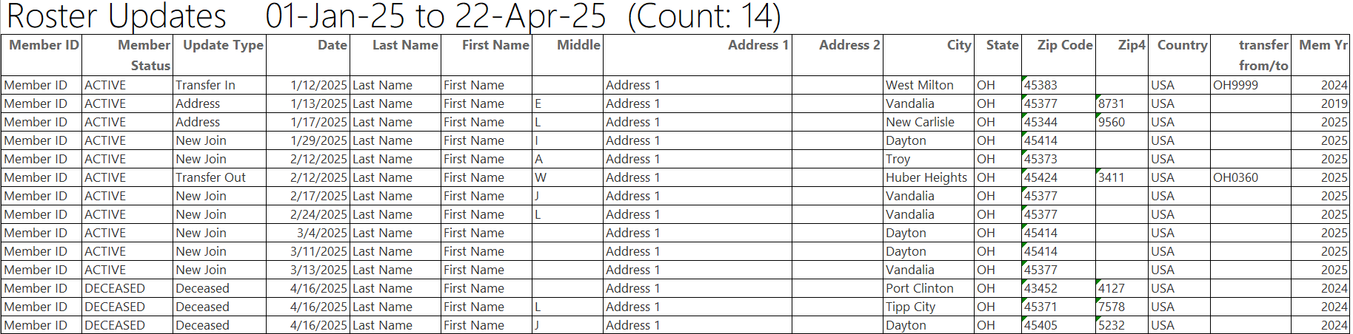
ROSTER UPDATES
Notes:
To print or save, export to an Excel Document or PDF. <1>

Slide 27
Notes:
The report gives you information on updates made to the member record. Notice transfer information includes to and from information. Members who transfer out of your squadron no longer appear in current roster or current membership reports. Paid members who transfer out will be included in the Paid Members report.

Slide 28
Notes:
.

Slide 29
Notes:
Dues history report displays payment information from 2011 to present.

Slide 30
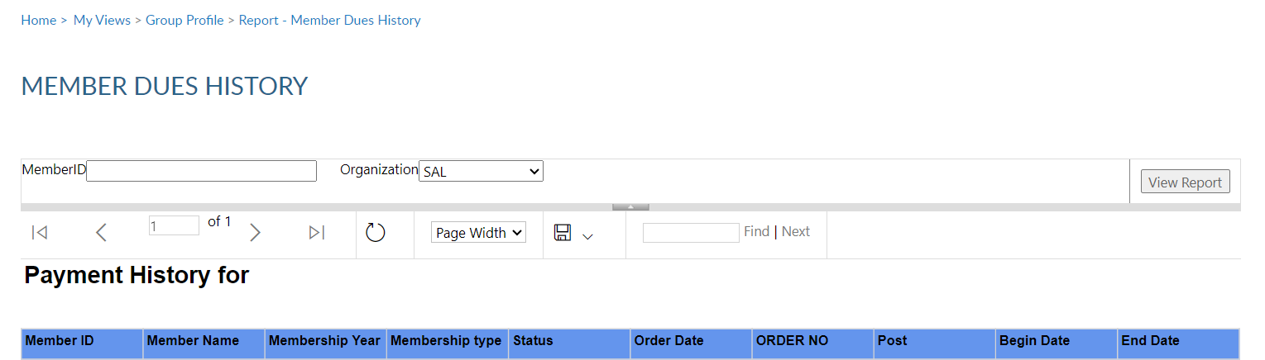


MEMBER DUES HISTORY
Displays member payments from 2011 to current.
Squadron
Notes:
Enter the 9-digit membership number and organization, <1> and click View Report. Use the export icon to save or print. <2>
Payment history includes 2011 to present. If more payment information is needed, contact your department headquarters. Departments can work with national headquarters to view archived data.

Slide 31
Notes:
The Paid Members report is the report corresponding with Department membership reports. It includes all members paid for the current year, even if they transferred out.

Slide 32


PAID MEMBERS
Paid members for the current membership year. Includes members who paid yet transferred out.
Notes:
Enter organization, group, and last paid year. Click View Report <1> to generate. Export the report to save and print. <2>

Slide 33

Paid Members By Squadron
Notes:
This report provides members paid to the post, even if transferred out. It also identifies the renewal type and batch number. The paid members report will correlate with detachment membership goals reports.

Slide 34
Paid Members By Squadron

Slide 35
Paid Members By Squadron

Slide 36
Notes:
3x10 labels produce a 30 per sheet label that fits Avery 5160 or any 30/sheet blank labels.
Click on the blue hyperlink to set filters and create labels.

Slide 37


LABELS
30 per sheet mailing labels.
Notes:
Filtering options allows you to define the members included in labels. Deceased and members flagged as undeliverable will be suppressed from mailing labels.
The first step is to select the group. Next, select the last paid year or multiple years. <1> Designate if you want your labels sorted by last name or zip code.
After parameters are set, View Report to continue. <2>

Slide 38


LABELS
30 per sheet mailing labels.
Max A Sample
PO Box 123
Somewhere, OH 45377-2835
Thomas Sample
123 Main Street
Somewhere, OH 45377-2835
Notes:
The label display is not in 30/sheet format. Send the data to a PDF document selecting the export icon. <1> The export icon is used print and save all reports using the file types in the menu. PDF is the only selection that applies for labels. After you select PDF look for a tab to open the PDF generally located at the lower left of your window.

Slide 39


Notes:
The PDF opens to print labels. Use the print icon to send to your printer.

Slide 40

Notes:
A renewal letter and labels are available to reach out to expired members.

Slide 41

RENEWAL LETTERS
Pre-written custom letter inviting expired members to renew. Create labels for your letter using the same filter criteria.
Notes:
Creating the letter begins with filters. Select the group first. This populates the contact name and title with commander information. <1> These fields can be modified by typing new text in the fields.
<2> Enter last paid year or multiple years, and sort option. Only expired years will be available. Click <3> View Report to generate.

Slide 42



Notes:
The personalized letter generates. Letters need to be exported to print. Using the export icon, export to a PDF <1>.

Slide 43



Notes:
The letter is personalized using member and squadron information including dues and dues remittance address. <1> The bottom of the letter includes a remittance slip with dues amount and member information. If there is missing contact information, a line is provided for the member to complete and return with dues.

Slide 44
Notes:
You can create labels for renewal letters. Go to Renewal labels and use the same criteria used for letters.

Slide 45
Legion Only
Notes:
Find Members in my Area and Project Stay active are reports for Legion only.

Slide 46

Notes:
Monitor who has access to your group in MyLegion using the MyLegion Access report.

Slide 47


MYLEGION ACCESS
Monitor who has access to your group in MyLegion. Adjutants and Commanders have access by default.
Notes:
The group menu displays who you have access to maintain. District and county administrators will have a listing of all posts or squadrons in your group. Click View Report. <1>

Slide 48


Notes:
Adjutants and Commanders will have access by default and have access to manage permissions. To update permissions, search the member record and go to Assign Group Permissions. Contact your detachment headquarters to apply and end date.

Slide 49
Legion Only
Notes:
Post officers within district report is for Legion only at this time.

Slide 50
Notes:
The last report, Post/Squadron Health Status, is for district and county officers.

Slide 51


POST HEALTH STATUS
Monitor squadron membership processing and consolidated reporting.
Notes:
Monitor membership processing and consolidated reporting for squadrons in your group. Group selection will include district and county groups. Enter your group, last paid year and <1> View Report. <2>

Slide 52

Notes:
The list provides squadrons with their last transmittal date, number of unpaid members, consolidated report status, and address information.

Slide 53

000123456789
PrimaryEmailAddress.com
000123456789
Notes:
Online help is available from the top Menu “Find Help”.
Step by step instructions, videos and training presentations will assist with how to manage groups in MyLegion.

Slide 54

Online Help
Notes:
Step by step instructions, videos and training presentations will assist with how to manage groups in MyLegion. My Groups instructions include managing membership, online, membership processing, reports and all other administrative tasks.

Slide 55
MYLEGION SUPPORT
MyLegion@legion.org
833.253.9995
Monday – Friday
8:00am – 4:30pm
(Eastern)
The American Legion National HQs
5745 Lee Road
Indianapolis, IN 46216
Contact your MyLegion support team to assist with any questions or tools on your MyLegion account.
Notes:
Contact your myLegion support team to assist with questions and tools for MyLegion. Email mylegion@legion.org or call 833-253-9995 Monday through Friday.

